Slide 1
Computer Graphics
Autumn 2025, Lecture 7: Raytracing
Kartic Subr

Slide 2
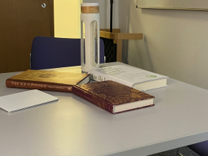
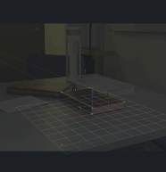
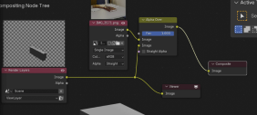
Lab 1: Setting Blender’s camera to match
Input image
Extract camera parameters
Import camera to blender
Model+render in blender
Composite rendered image, with transparency
on background photograph
82 students out of 84 attended
All 82 achieved the objectives!

Slide 3
Raytracing?

Slide 4
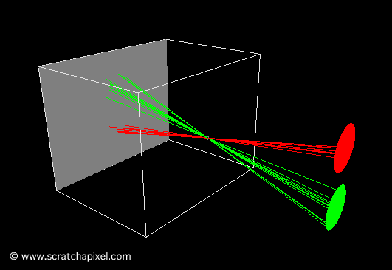
Pinhole camera
Ibn al-Haytham (965-1040 AD)

Slide 5
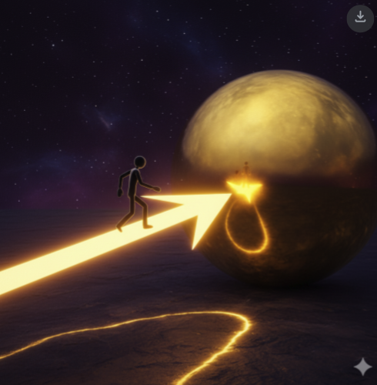
How would you track rays?

Slide 6
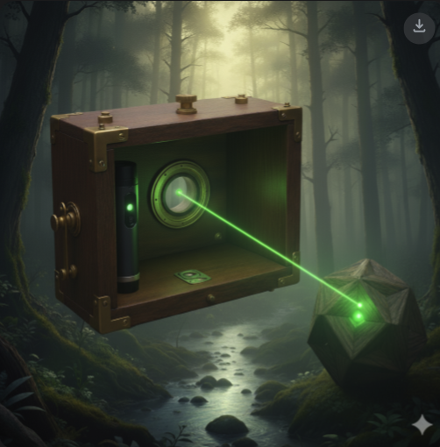
Laser pointer from film through pinhole …

Slide 7
Albrecht Dürer,
1525
Computer Graphics: Principles and Practice, Third Edition by Kurt Akeley, Steven K. Feiner, James D. Foley, David F. Sklar, Morgan McGuire, Andries van Dam, John F. Hughes. See this video

Slide 8
Johannes Vermeer 17th Century

Slide 9
Vermeer’s comparator mirror

Slide 10
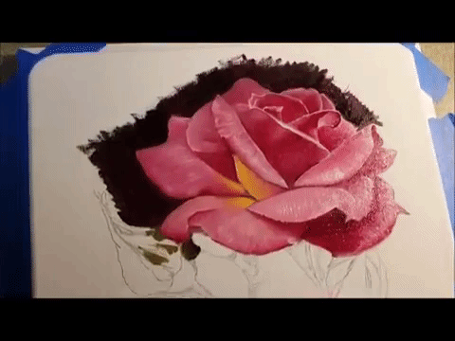
Vermeer’s comparator mirror
https://youtu.be/deAK0oV6Vt8

Slide 11
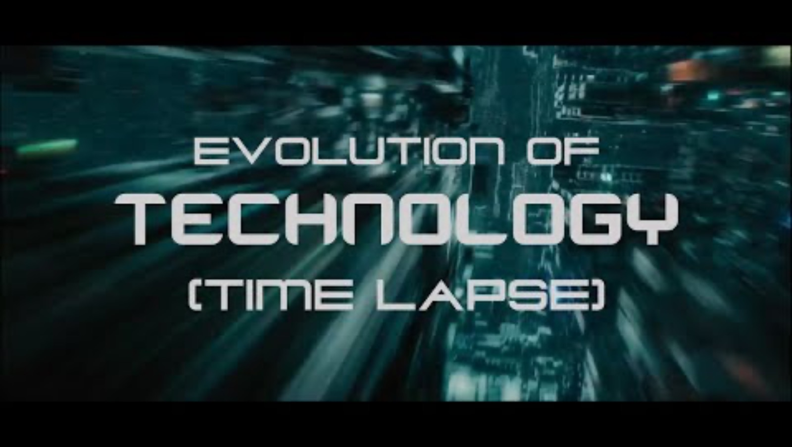
The next 200 years …

Slide 12
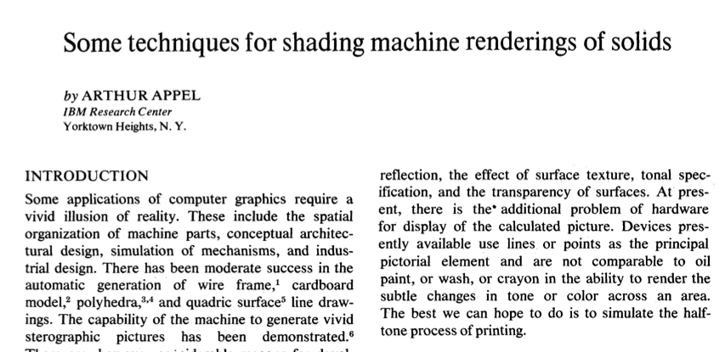
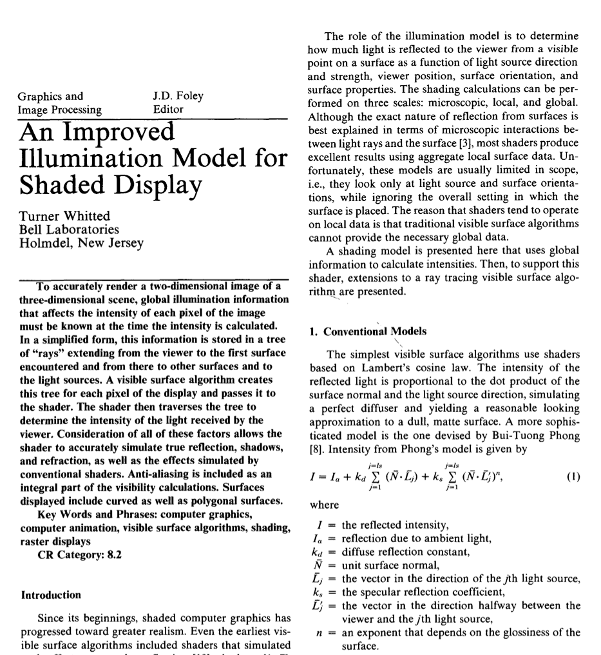
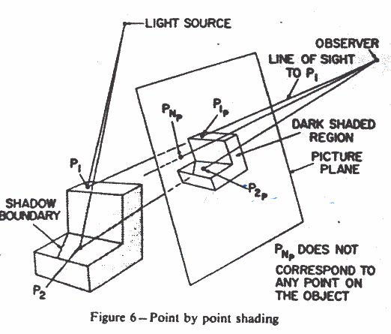
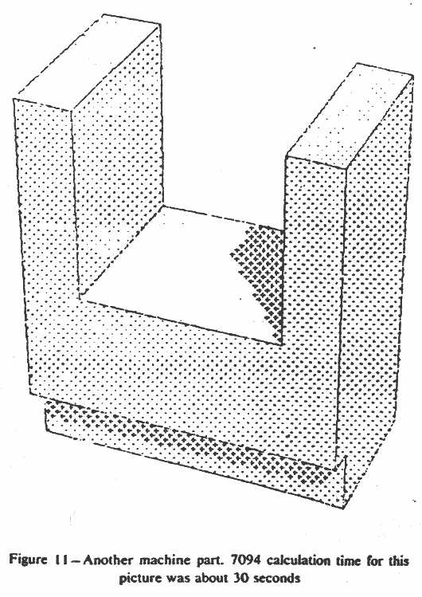
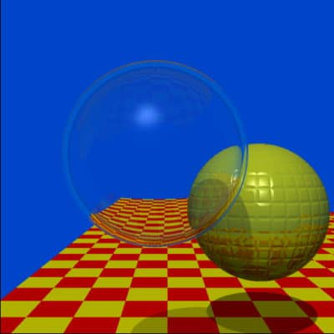
1968
1979

Slide 13
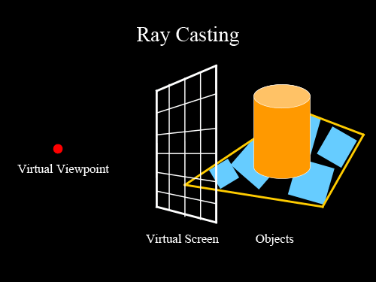
Ray casting
image credit
http://studiomaven.org/Context__Overview_of_Ray-Traced_Rendering.html

Slide 14
Ray casting
for each pixel p
cast ray r through p into the scene
test if r intersects objects in the scene
if yes
find closest intersection point h
shade h
else
return background colour (black)
endif
1
2
3
image credit
http://studiomaven.org/Context__Overview_of_Ray-Traced_Rendering.html

Slide 15
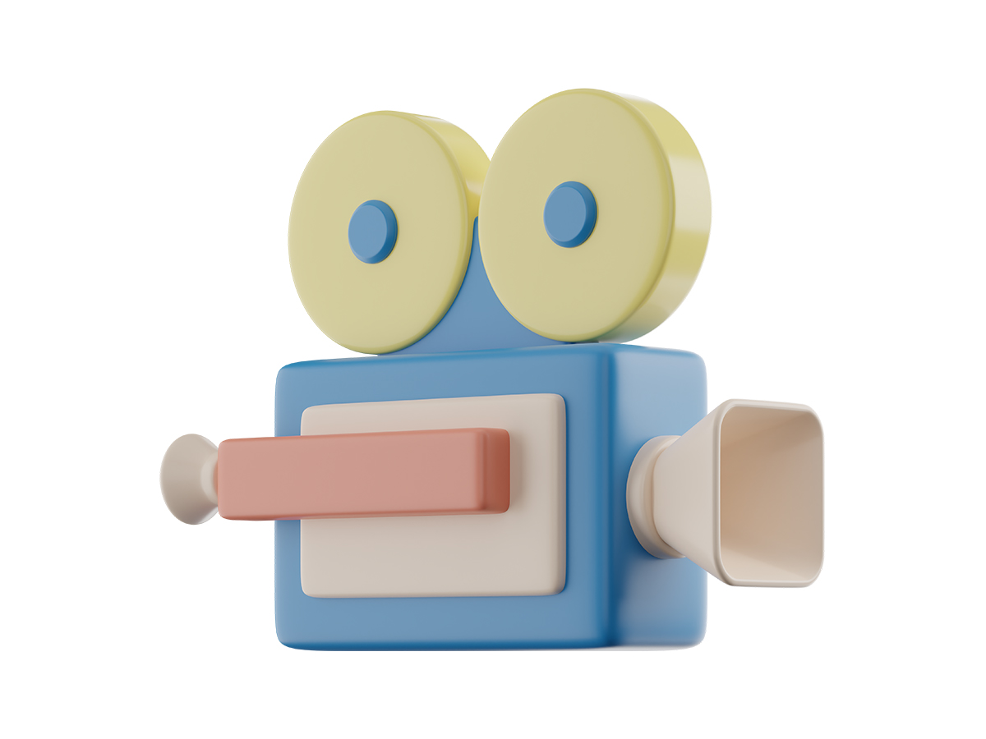
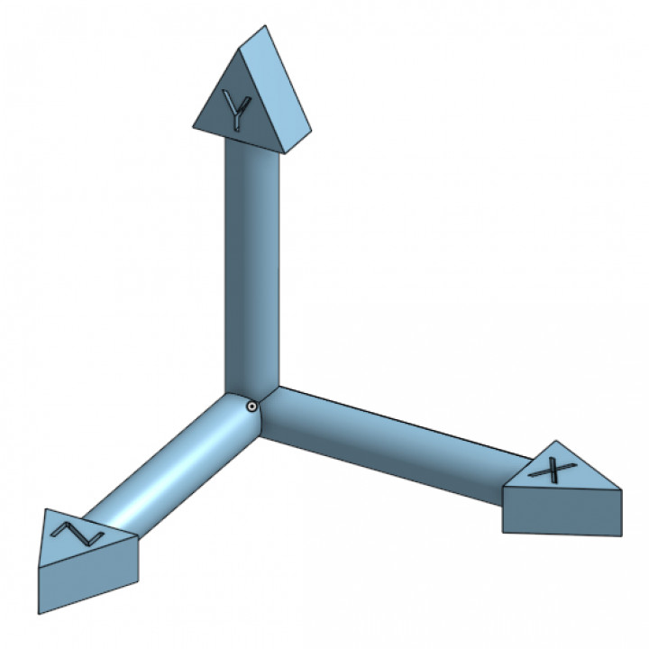
Ray casting
https://www.americanscientist.org/article/a-pixel-is-not-a-little-square

Slide 16
Ray casting
Ch. 4 Fundamentals of Computer Graphics
Coursework Module 1!
https://graphicscompendium.com/raytracing/02-camera

Slide 17
Ray intersection
p
r
intersection point ?

Slide 18


Ray – plane intersection
Ray origin and direction
Point and normal defining the plane
Hit point

Slide 19


Ray – plane intersection

Slide 20

Ray – plane intersection

Slide 21
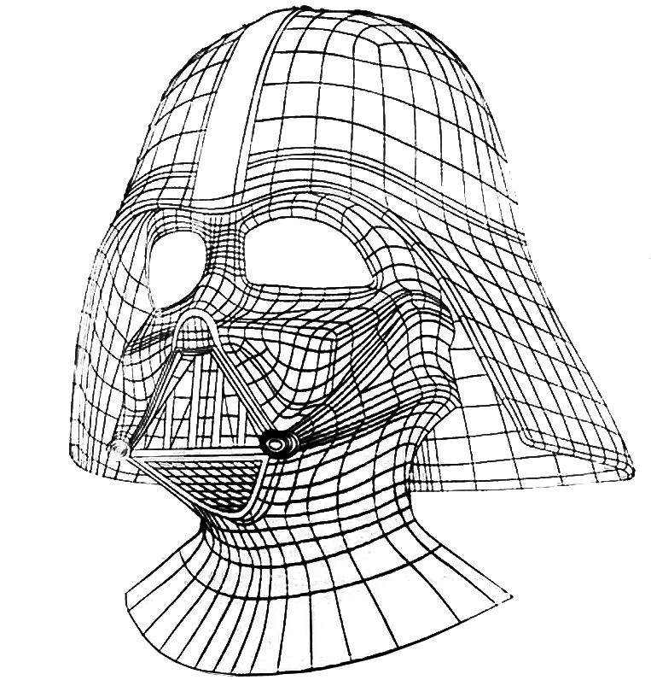
Computation: test many objects
hit!
missed

Slide 22
Speed up testing many objects?
Discuss with your neighbour(s) and propose strategies

Slide 23
Acceleration data structures
grids
- uniform
- adaptive e.g. octree
bounding box
- simple
- concave objects?
arbitrary bounding volume
- ‘tight’ but more tests
- concave objects?

Slide 24
Acceleration technique

Slide 25

Acceleration: bounding volume hierarchy

Slide 26
Acceleration: bounding volume hierarchy
test ray at highest level
- recurse based on intersection result
Interested readers: slides

Slide 27
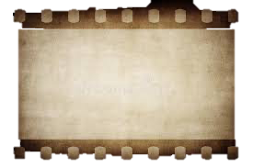
Video games: 0.5 billion rays per second!
60 frames per second
4K (UHD)
3840 x 2160
8.2 million pixels

Slide 28
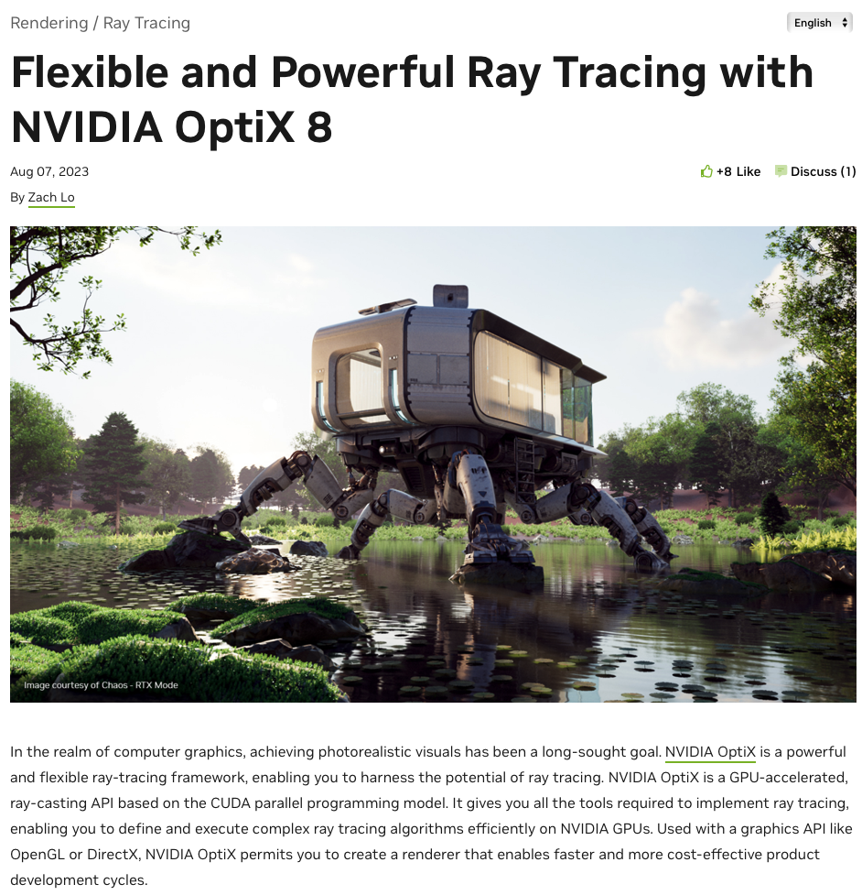
Ray intersection - GPU
https://developer.nvidia.com/blog/flexible-and-powerful-ray-tracing-with-optix-8/

Slide 29
Ray intersection - GPU
- Reduce computation time by executing parallel tests
Reduce number of tests via acceleration structures
trade off: building data structures and book-keeping
exploring data structures may not be easy or efficient

Slide 30
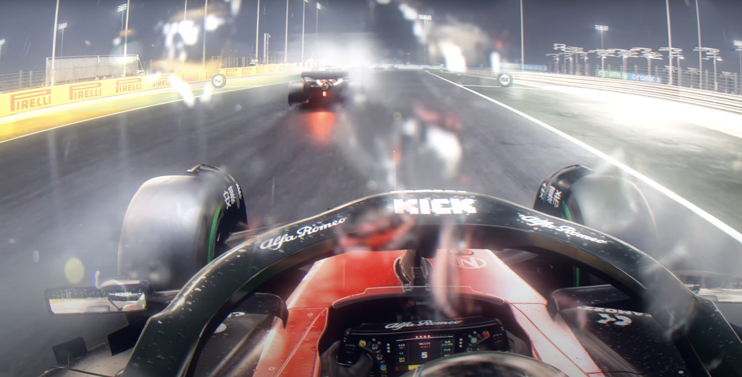
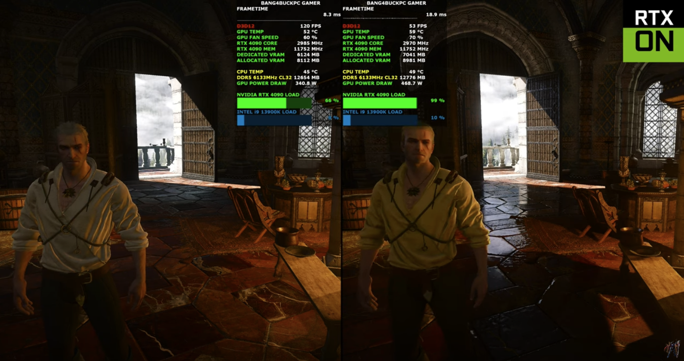
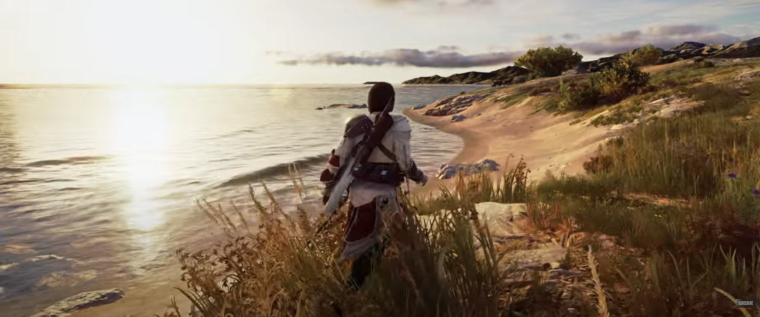
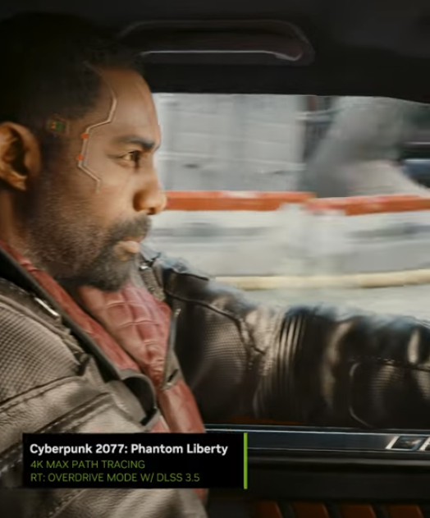
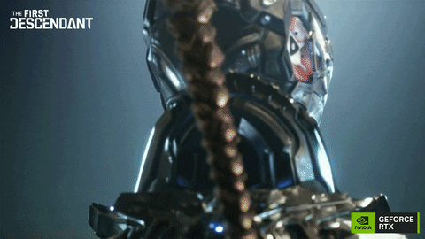
NVIDIA 4090
Some games with good visuals: here
~£1800, > 10b rays/s
https://www.youtube.com/watch?v=QHX8ktPFB9k
https://www.youtube.com/watch?v=dbSdvV_YU8U
https://www.youtube.com/watch?v=UZ_9-fklLns

Slide 31
Ray intersection
2
p
r
intersection point ?
Hit structure
- intersection
- distance from p
- normal
- material …

Slide 32


Shading: How much light?

Slide 33
Approximation!

Slide 34
Shading: approximation
ambient light (constant)
+
diffuse
+
specular reflection of light

Slide 35
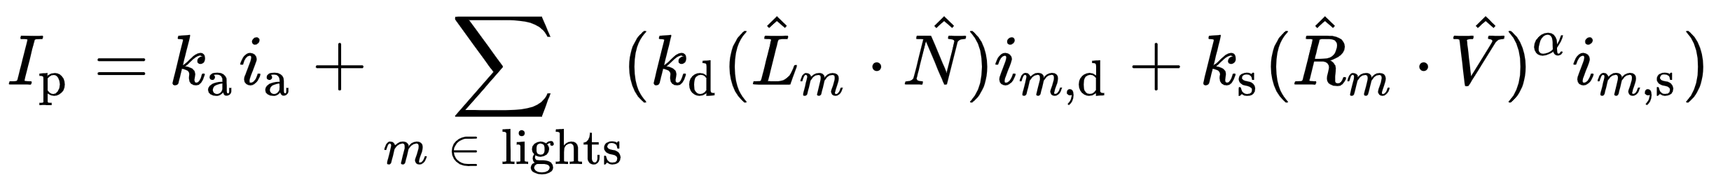
Blinn-Phong shading
material property
ambient
diffuse
specular
light property
R is the mirror reflection direction
source:wikipedia

Slide 36
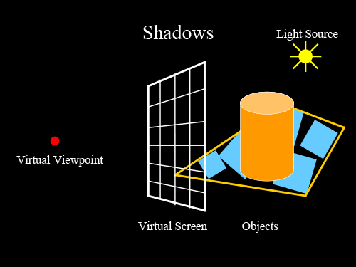
Shadows
image credit
http://studiomaven.org/Context__Overview_of_Ray-Traced_Rendering.html

Slide 37
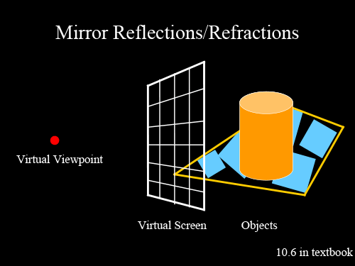
Mirror (specular) reflection/refraction
image credit
http://studiomaven.org/Context__Overview_of_Ray-Traced_Rendering.html

Slide 38
Reflection

Slide 39
Resources
https://www.cs.utah.edu/~shirley/books/fcg2/rt.pdf
http://www.cs.utah.edu/~shirley/papers/rayedu.pdf
http://www.realtimerendering.com/raytracing/roundup.html
http://rtintro.realtimerendering.com/
https://benedikt-bitterli.me/tantalum/tantalum.html

